Slide 1
Sprechen Sie MLA?
An Introduction to MLA-8

Slide 2
FOREIGN LANGUAGE
it will probably sound like I'm speaking a foreign language -
using words & phrases that sound so alien to you
it's a process -
no one "gets it" on his/her 1st pass
no one starts speaking "fluent MLA" on the 1st day
*it takes time, patience, & practice
practice makes perfect (at least, familiar) -
the more you use it, the more familiar it becomes
it starts to make sense

Slide 3
FOREIGN LANGUAGE
use it or lose it
practice, practice, practice
this is why we will do several exercises, abstracts, & essays
otherwise, like a foreign language, you will start to lose what you've gained
there is a "grammar" to MLA
a set of rules that govern when to do what
they are precise -- this is exactly where the period goes, e.g.
once you get "the hang of" these rules, everything starts making sense

Slide 4
ANALOGIES
Other Analogies—
Learning to Drive
New vehicle
Software updates

Slide 5
MLA-8

Slide 6
MLA-8
Modern Language Association
“modern” as opposed to Classical (Greek, Latin)
MLA:
others = APA (social sciences), Chicago (history), APSA (political science), CSE (natural science), IEEE (engineering & computer sci.)
8th edition
“simplify”
digital sources

Slide 7
TODAY
We will focus on 2 main parts of MLA-8:
the Works Cited page
Parenthetical (in-text) Citations

Slide 8
MLA 8
Works Cited Page

Slide 9
WORKS CITED
Creating bibliographic citations
1 citation
3 main parts
9 core elements

Slide 10
WORKS CITED
9 core elements:
Author.
Title of Source.
Title of Container,
Other contributors,
Version,
Number,
Publisher,
Publication date,
Location.

Slide 11
WORKS CITED
(1) Author.
0 author = leave blank & move on to next section
1 author = Last, First.
2 authors = Last, First, and First Last.
3+ authors = Last, First, et al.
NO: professional degrees or titles
IF your focus is on a role other than author, add that after the name:
Last, First, editor.
+ period
REVERSE the FIRST

Slide 12
WORKS CITED
(2) Title of Source.
“QUOTATION MARKS”
part of a whole (“short”)
articles, chapters, blogs, songs, episodes, short stories, essays, photographs, 1-act plays, short poems
ITALICS
the whole; a self-contained work (“long”)
books, movies, video games, court documents, plays, novels, pamphlets, brochures, sculpture, painting
+ period

Slide 13
WORKS CITED
Container:
“contains” a number of works
“contains” your source
journal, magazine, newspaper, site
*some sources have 2+ containers
databases
e-books
internet streaming services

Slide 14
WORKS CITED
Container:
this part
gives info re: where & how to find your source
has 7 parts
each separated by a COMMA
*BUT* not all will be relevant to your source
in that case, leave it blank

Slide 15
WORKS CITED
(3) Title of Container,
your source = part of a whole
that whole = the container
italicized + comma
journal, magazine, newspaper, site, TV series, CD
Shakespeare Quarterly, Newsweek, New York Times,
+ comma

Slide 16
WORKS CITED
(4) Other contributors,
roles other than “author”
edited, translated, illustrated, narrated, adapted, introduced
not abbreviated
+ “by” First Last,
capitalized after period (1st word only)
not capitalized after comma
Foucault’s Pendulum. Translated by William Weaver,
Umberto Eco Tribute Page, edited by John Schmigliessa,
+ comma

Slide 17
WORKS CITED
(5) Version,
special edition of a work, movie, video game
version of software or phone app
not abbreviated
capitalized after period (1st word only)
not capitalized after comma
book: The Da Vinci Code. Illustrated edition,
site: Dan Brown Fan Site, version 2.0,
+ comma

Slide 18
WORKS CITED
(6) Number,
Scholarly Journals often have volume and issue numbers
as do Multi-Volume Works (too long to fit in one)
VOLUME & ISSUE
vol. + comma + no. + comma
vol. 5, no. 22,
SEASON & EPISODE of TV shows
season 10, episode 3,
+ comma

Slide 19
WORKS CITED
(7) Publisher,
BOOKS, TV SHOWS, MOVIES—
abbreviate “University Press” as UP
omit words/abbreviations for Co., Inc., Corp., Ltd.
TV shows & movies often have multiple sources –
choose the primary producer or distributor (listed 1st)
+ comma

Slide 20
WORKS CITED
(7) Publisher,
SITES —
publisher, school, sponsoring organization
look for the Copyright Date © at the bottom of the page
omit publisher for journals, magazines, newspapers
omit publisher for personal blogs
omit publisher for site with the same name*
omit publisher for “warehouses” not responsible for the content or work (*databases, YouTube, WordPress)
+ comma

Slide 21
WORKS CITED
(8) Publication date,
DATE of PUBLICATION = latest date of publication
(revised, edited)(most recent edition or version)
*FORMAT*
Day Month Year
10 Oct. 2010,
Jan., Feb., Mar., Apr., May, June, July, Aug., Sept., Oct., Nov., Dec.
TV Shows & Movies: = year only
*if your focus = on the historical context of the episode, then full date
*DVD sets = year of DVD release + comma + disc #.
2012, disc 2.
COMMENTS: (to online articles or posts) = time of post, too
19 Oct. 2016, 11:47 a.m.,
+ comma

Slide 22
WORKS CITED
(9) Location.
PRINT SOURCES:
Page Numbers—
“p.” for page or “pp.” for pages
pp.36-75.
CONTINUOUS PAGINATION:
use the range of pages--
pp. 44-80, pp. 123-34, pp. 1176-91
limit the 2nd number to 2 digits (132-45)
NON-CONTINUOUS PAGINATION:
use the 1st page number and "+"
pp.65+
+ period

Slide 23
WORKS CITED
(9) Location.
ONLINE SOURCES: (Web sites)
a) DOI (Digital Object Identifier)
*preferred
doi + colon + number + period
b) permalink
under the “share” button
c) URL (Universal Resource Locator)
do not use shortened link
do not use “http://” for any URL
do not use <carets> around any URL
*break URLs after single slash (/) only
+ period

Slide 24
WORKS CITED
(10) OPTIONAL INFORMATION-
some additional info might be necessary to help readers find your source – esp. if source is updated
*Access Date
same format as the Publication Date
after the period following the Location.
“Accessed” + date.

Slide 25
MLA-8
TYPES of SOURCES

Slide 26
TYPES of SOURCES
WEB SITE:
Last, First. "Article." Site Name, Site Publisher If Needed, Date of Publication (most recent), Location (DOI or permalink or URL).
“Chronic Traumatic Encephalopathy.” SayOw55, Seau Foundation, 2016, www.sayow55.org/CTE/ causes/24802. Accessed 19 Oct. 2016.

Slide 27
TYPES of SOURCES
SCHOLARLY JOURNAL:
PRINT COPY:
Last, First. "Article." Journal Name, volume number, issue number, Date of Publication (most recent), page numbers.
ONLINE VERSION:
Last, First. "Article." Journal Site, volume, issue number, Date of Publication, page # if there, URL. Access Date.
Stephens, Robert. “Bottom’s Dream.” Shakespeare Online Journal, vol. 8, no.12, 1 Apr. 2009, pp. 43-54, www.ShakespeareOJ.org/ April/2009/ MSND/Bottom.pdf. Accessed 23 Apr. 2016.

Slide 28
TYPES of SOURCES
NEWSPAPER, MAGAZINE:
Last, First. “Article.” Newspaper, date, page number/s. ◦for the page number, include the section if it has one
add the edition after the date
add [city] after the name
replace p.# with the URL. Access date. if online
Paulson, Robert. “Fight Club Suspected in Chicago.” The Chicagoan, 11 Nov. 1999, morning edition, pp. A6-7.

Slide 29
TYPES of SOURCES
DATABASE ARTICLES:
*2 CONTAINERS:
1.the original publishing information
2.the database from which you retrieved the article
Last, First. "Article." Journal Name, volume number, issue number, Date of Publication (most recent), page numbers. Database Name, Location (DOI or permalink or URL).

Slide 30
TYPES of SOURCES
GOVERNMENT:
the government hierarchy is used as the "Corporate Author"
start with the government & then proceed – in hierarchal order – through the agencies, bureaus, departments, divisions – until you get to your source
Matryoshka (nesting) dolls: pecking order
each item separated by a COMMA
government = federal (United States) or state (Maryland)
United States, Dept. of Health and Human Services, Centers for Disease Control and Prevention, National Center for Emerging and Zoonotic Infectious Diseases, Division of Vector-Borne Diseases. + then the article…..

Slide 31
TYPES of SOURCES
BOOK:
Last, First. Book Title. Publisher, date of publication.
(a period comes after the book title because it is a self-contained whole)
*no city of publisher
most recent date of publication
Stephens, Robert. Shakespeare’s Maimed Rites. Bottom Books, 2016.

Slide 32
MLA 8
WC Page EXERCISES

Slide 33
EXERCISE
YOUR SOURCE = BOOK
Author = Jayne Smith, Joy Jones
Title = Guide to MLA 8
Publisher = Luzerne UP
Date of Publication = 2016

Slide 34
EXERCISE
ANSWER =
Smith, Jayne, and Joy Jones. Guide to MLA 8. Luzerne UP, 2016.

Slide 35
EXERCISE
YOUR SOURCE = WEB ARTICLE
Author = Robert Stephens
Title = Ellipses in MLA 8
Site Name = MLA-Man
Publisher = LCCC
Publication Date = April 1, 2016
URL = www.mla-man.edu/mla8/ellipses
Access Date = October 19, 2016

Slide 36
EXERCISE
ANSWER =
Stephens, Robert. “Ellipses in MLA 8.”
MLA-Man, LCCC, 1 Apr. 2016, www.mla-man.edu/mla8/ellipses. Accessed 19 Oct. 2016.

Slide 37
MLA 8
Parenthetical Citations

Slide 38
PARENTHETICAL CITATIONS
Why We Document:
“college” = high standards of writing & research
“conversation”: researchers are part of a conversation with researchers from the past, present, and future
“credibility”: citing our sources shows are respect for ourselves as scholars, for our school & its education reputation, for our subject, and for the source’s author

Slide 39
PARENTHETICAL CITATIONS
Why We Document:
A very practical reason:
To play Research Frogger
Our citation gets readers to our Works Cited page
Our WC page gets them to the source
Where they can find our material in its context

Slide 40
PARENTHETICAL CITATIONS

Slide 41
PARENTHETICAL CITATIONS

Slide 42
CORE ELEMENTS
AUTHOR | just the Last Name (when not used in the Lead-In Expression)
(2) PAGE NUMBER | no “p.” or “pp” for page numbers just the numeral found in print versions of books, magazines, journals, newspapers seen onscreen with numbered pages, .pdf files
Example: | (Smith 679). *no punctuation between elements…ordinarily

Slide 43
CORE ELEMENTS
AUTHOR:
**The 1st item (correctly) on the Works Cited page = The 1st item in the Parenthetical Citation**

Slide 44
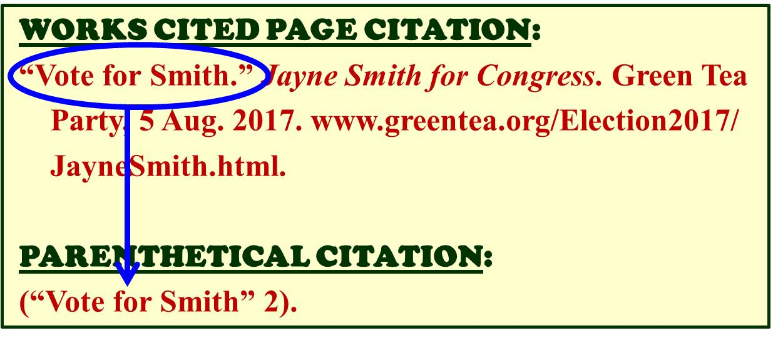
CORE ELEMENTS
If there’s no AUTHOR:
**The 1st item (correctly) on the Works Cited page = The 1st item in the Parenthetical Citation**

Slide 45
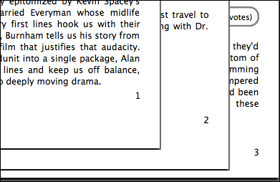
CORE ELEMENTS
Page Number:
Only if they appear in print or on the screen – not the printer’s numbers
PARENTHETICAL CITATION:
(Smith 2).

Slide 46
BONUS INFO: Authors
0 AUTHORS:
when a source has NO AUTHOR—
use the next item in the Bibliographic Citation (the Works Cited page entry)
usually it is the “Article Title” (keep “QM”)
(but could be the Book Title) (keep <i>)
the title can be shortened/truncated if it is too long
(*as long as it does not create confusion with another title)
EXAMPLE:
(“The Causes and Effects of Fibromyalgia” 45).
(Neurological Disorders 462).

Slide 47
BONUS INFO: Authors
2 AUTHORS:
when a source has 2 AUTHORS--
Last Name + and + Last Name
(not an ampersand -- &)
EXAMPLE:
(Lewis and Clark 557).
(Martin and Lewis 2).

Slide 48
BONUS INFO: Authors
3+ AUTHORS:
when a source has 3 or more AUTHORS--
Last Name of the 1st author indicated in the source + et al. (“and others”)
the “al” needs a period after it because it is an abbreviation
EXAMPLE:
(Jeter, et al. 2).
(Fouts, et al. 14).

Slide 49
BONUS INFO: Authors
2+ WORKS by the SAME AUTHOR:
Add the next item on the bib. citation--
Last Name + comma + Source
EXAMPLE:
(Loman, “Causes of Depression” 213).
(Loman, “Overcoming Depression” 89).

Slide 50
BONUS INFO: Authors
2+ WORKS without AUTHORS from SAME SOURCE:
Add the next part of the bib. citation--
"Article Title" + comma, inside the QM + Source
EXAMPLE:
("Gluttony," 7DeadlySins.org, par.2).
("Avarice," 7DeadlySins.org, par.9).

Slide 51
BONUS INFO: Authors
2+ AUTHORS with the SAME LAST NAME:
Add the First Initial--
1st initial + period + Last Name
(use the full 1st name if the initials are the same)
EXAMPLE:
(C. Van Doren 98).
(M. Van Doren 114).

Slide 52
BONUS INFO: Locators
If your source does not have page numbers
Then use some other fixed numbered locator to help readers locate the context of your sources
Numbered paragraphs
Numbered chapters, sections, parts, books
*add a comma

Slide 53
BONUS INFO: Locators
PARAGRAPH NUMBERS:
numbered onscreen
Last Name + comma + par.#
EXAMPLE:
(Smith and Wesson, par.5).
(Smith and Wesson, pars.1-3).

Slide 54
BONUS INFO: Locators
Chapter, Section, Part, Book #s:
numbered onscreen
Last Name + comma + ch.# (or sec.#, pt.#, bk.#)
EXAMPLE:
(Thompson, ch.2).
(Ruger, secs.7-8).
(Colt, pts.44-45).
(Winchester, bk.9).

Slide 55
BONUS INFO: Locators
VIDEO TIME CODES:
for audio or video TIME-BASED MEDIA, use the TIME CODE for the location
videos, movies, podcasts
songs, recorded lectures
hour + colon + minute + colon + second
EXAMPLE:
(Fight Club 00:54:23).
(Durden 01:32:48).
NO COMMA

Slide 56
BONUS INFO: Locators
*if your source has NO numbered parts
then you cannot use locators
instead, describe the location in the LEAD-IN EXPRESSION
(if the author is in the Lead-In, too, then no citation)
EXAMPLE:
In the third paragraph of Ebert’s review, ….
Under the subheading ‘Symptoms,’ Smith….

Slide 57
SUMMARY
*BASIC IN-TEXT CITATION SET UP*
SOURCE with an AUTHOR | SOURCE without an AUTHOR
(Smith 241). (Smith, par.3). (Smith, ch.19). | ("Anorexia Nervosa" 648). ("Anorexia Nervosa," par.8). ("Anorexia Nervosa," ch.7).

Slide 58
MLA 8
WC Page EXERCISES

Slide 59
PC EXERCISE
Authors = John Schmigliessa and John Pfapfunick
Book = The Military Police
Pages = 34 to 35

Slide 60
PC EXERCISE
Answer =
(Schmigliessa and Pfapfunick 34-35).

Slide 61
PC EXERCISE
Author = none
Article = Seau’s Sad Suicide
Pages = paragraph 55

Slide 62
PC EXERCISE
Answer =
(“Seau’s Sad Suicide,” par.55).

Slide 63
MLA 8
THE END

