Slide 1
IOE
INFORMAL OPINION ESSAY

Slide 2
THE BASICS

Slide 3
BASICS
Basically, this is a PRO-CON paper –
Choose a side of a serious societal issue
Argue for it
OR
Argue against it
(not both!)
LENGTH = 2-3 pages

Slide 4
BASICS
“INFORMAL”
as in no research
not as in poor writing, slang, or other informalities
While this is “informal” in terms of no research & your opinion,
It will not read like a text, email, or blog
Maintain FORMAL ACADEMIC WRITING standards & PROOFREAD!

Slide 5
BASICS
“OPINION”
make a Claim concerning your topic & support it
For example, what is your opinion regarding abortion or health care reform or immigration?
argue for or against – we should or we should not
no research - just your organized, well-worded ideas on the topic

Slide 6
BASICS
“ESSAY”
follow the tenets of the “Essay Basics”
TITLE
INTRODUCTION
concluding w/a THESIS STATEMENT
BODY
1 reason/argument per paragraph
3 paragraphs
arranged in the EMPHATIC ORDER
CONCLUSION

Slide 7
BASICS
*NO RESEARCH*
none, nada
zip, zilch, zero
SUPPORT =
personal anecdotes
hypotheticals

Slide 8
TOPICS

Slide 9
TOPICS
Since there is to be no research
Choose a topic that you are quite familiar with
One that you have probably “gone off on a rant” with before
Do your family/friends groan, “Here she goes again!” when you bring up this topic?
Perhaps one related to your major or major interest

Slide 10
TOPICS
Still…
While the topic is meaningful to you
It should still have some societal importance
Something that affects the rest of us
Something beyond “my girlfriend drives me crazy” or “my parents should allow me to do whatever I want”
some hot-button topic
a contemporary controversial issue

Slide 11
TOPICS
OPPOSING VIEWPOINTS:
We have access to the Opposing Viewpoints database
& on it are “opposing viewpoints” on various topics
2-sided issues of societal importance
So looking at its LIST of SUBJECTS could give you an idea for a topic for your paper
but remember: NO RESEARCH
(you’re just looking here for topic ideas)

Slide 12
TOPICS
Also
I skim the newspaper shortly before this assignment
& “rip from the headlines” a list of possible topics
local & national news
sports
entertainment
even the ads can give us ideas for topics

Slide 13
SET UP

Slide 14
SET UP
FONT =
Times New Roman
12”
LENGTH =
2½ to 3 pages
(certainly no fewer)

Slide 15
SET UP
NO cover page
On the top right of page #1
HEADER (single-spaced)
Your Name
My Name (Dr. Housenick)
Course & Section #
Due Date
Name of Essay
see The House Rules & Essay Basics docs

Slide 16
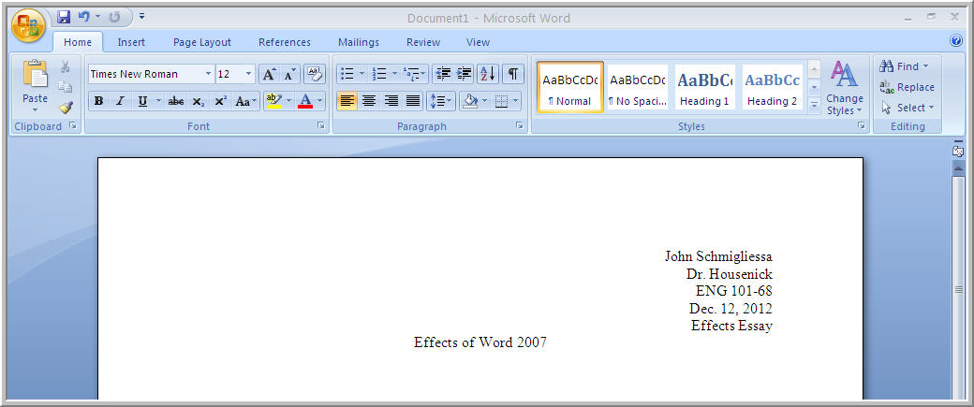
SET UP
PAGE #1 HEADER
John Schmigliessa
Dr. Housenick
ENG 102-001
Feb. 12, 2025
IOE
Against Embryonic Stem Cell Research

Slide 17
SET UP
On the top right of pages #2, 3, 4
HEADER
Your Last Name
Hyphen
Page Number
see Word 2010 Changes docs

Slide 18
SET UP
PAGES #2+ HEADER
Schmigliessa-2

Slide 19
SET UP
TITLE
Centered
No Bold
No Underlining
No Quotation Marks
No ALLCAPS
see slide above

Slide 20
SET UP
TITLE
Make clear your ARGUMENT
TOPIC + MAIN IDEA
For Same-Sex Marriages
Against Same-Sex Marriages
In Support of the New Rules in Football
Opposing the President’s Gun Control Proposal

Slide 21
STRUCTURE

Slide 22
STRUCTURE
Headers
Title (For or Against)
Introduction w/ Thesis
Argument #1
Argument #2
Argument #3 (most important)
Conclusion

Slide 23
INTRODUCTION
Use the GENERAL CLIMATE to introduce your issue
Its CONTEXT
What’s been going on recently with it?
Who’s been saying what about it?
Any laws, law suits, protests, marches, speeches?
Has Michael Moore made a documentary on it?
NO
RESEARCH

Slide 24
INTRODUCTION
END the Intro with your THESIS STATEMENT
TOPIC + MAIN IDEA + SUPPORT
your ISSUE +
your STANCE/opinion on that issue +
your EVIDENCE in support of that stance
your 3 arguments

Slide 25
BODY PARAGRAPHS
ONE argument per paragraph
THREE total paragraphs
arranged in the EMPHATIC ORDER
best for last
and say so

Slide 26
PARAGRAPH STRUCTURE
NAME the point, argument, reason
TOPIC SENTENCE
clearly announce the point
EXPLAIN or clarify it
ILLUSTRATE the point
anecdote, hypothetical
REITERATE the point
CLINCHER SENTENCE
reiterate & clearly conclude the paragraph/point
NO RESEARCH

Slide 27
CONCLUSION
REITERATE your main points
echo your General Context
repeat your Thesis
repeat your main arguments in support of that claim
State your PURPOSE
SO WHAT?!
inductively move away from your point
and put it into a larger perspective
Why should we care, How will this affect us?
What’s at stake here?

Slide 28
SUBMISSIONS

Slide 29
SUBMISSIONS
SUBMIT your essay to ME by its due date
I will grade only this copy
SUBMIT your essay to TURNITIN.COM
too
to guarantee its authenticity
no grade will be released if a copy is not submitted to TII

Slide 30
ASSIGNMENT OBJECTIVES

Slide 31
ASSIGNMENT OBJECTIVES
narrow a broad subject to a focused topic
engage in a structured academic, reasoned argument
make a claim & support it with appropriate, relevant grounds
successfully apply the Essay Basics
proof read for grammar, mechanics, & style
follow directions well
utilize the Turnitin.com tool

Slide 32
ASSIGNMENT REMINDERS

Slide 33
ASSIGNMENT REMINDERS
Page #1 Header:
Your Name
Dr. Housenick
Course & Section #
Due Date
IOE
Pages #2+ Header:
your last name + hyphen + page number
Schmigliessa-2
see the “Word 2010 Changes” sheet
*NO RESEARCH*

Slide 34
ASSIGNMENT REMINDERS
Title:
your argument
TOPIC + MAIN IDEA
For Military Action on North Korea
Against Turnpike Deregulation
Thesis:
your argument + support
TOPIC + MAIN IDEA + SUPPORT
Thus, I support military action on North Korea because of their nuclear arsenal, their ties to al-Qaeda, and their involvement with Dennis Rodman.
*NO RESEARCH*

Slide 35
ASSIGNMENT REMINDERS
Point-of-View:
do not use YOU throughout
avoid RHETORICAL QUESTIONS
Pronoun-Agreement:
person & they/their = disagree
person & he/she or his/her = agree
persons or people & they/their = agree
*NO RESEARCH*

Slide 36
ASSIGNMENT REMINDERS
Paragraph Structure:
NAME the point/argument in the 1st Topic Sentence
EXPLAIN the point
ILLUSTRATE the point
REITERATE the point in the last Clincher Sentence
Emphatic Order:
save your “best” argument for LAST
best as in “most significant,” “most important”
& say so, in your Topic Sentence
*NO RESEARCH*

Slide 37
ASSIGNMENT REMINDERS
*DO NOT*
do not perform research of any kind
do not argue for AND against (just 1 side)
do not write a Narration, Illustration, Process, Classification, Contrast, or Effects essay
do not refute the “other side” of the argument (just prove your side)
do not use “you” (2nd person POV)
do not use Rhetorical Questions

