Slide 1
BIRTH of DRAMA
Ancient Greece

Slide 2
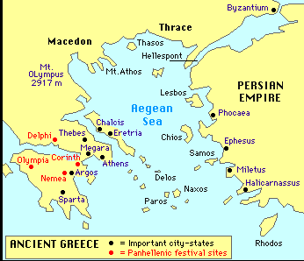
ANCIENT GREECE

Slide 3
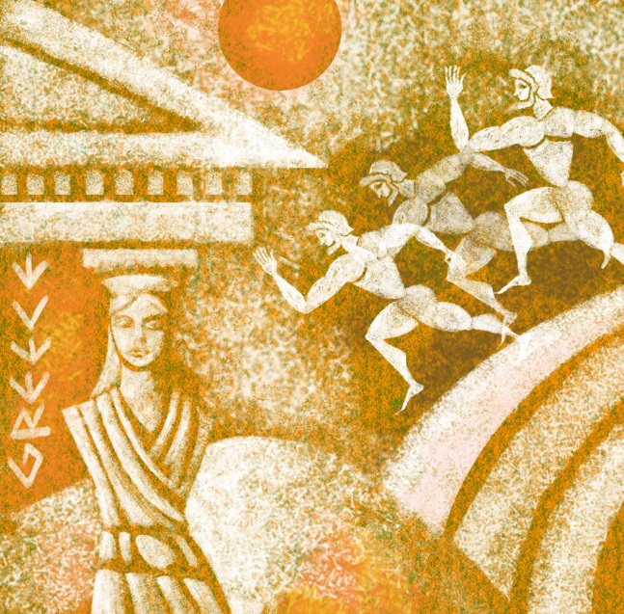
ANCIENT GREECE
developments: “Western Civilization”
history
politics (theory, democracy)
architecture
sculpture
philosophy
medicine
mathematics
…
theater

Slide 4
ANCIENT GREECE
landscape:
mountains
plains
1/3 of Greece is/was rock
(can’t grow/graze)
desolation, separation, isolation
customs, laws, traditions

Slide 5
ANCIENT GREECE
geographic isolation →
political/cultural individuation (city states) →
governmental decentralization →
external war & internal competition

Slide 6
ANCIENT GREECE
staples:
grain
olive
grape/vine (*DIONYSUS*)
fish
sea:
easier means of travel
fish
city-states = “like frogs […] around a pond” (Plato)
strong navy (Athens)

Slide 7
Persian Invasion
First Invasion: Darius the Great
Battle of Marathon (490 BC), Athenian victory
Second Invasion: Xerxes I
(480 BC)
Darius’ son, successor
Battle of Thermopylae
(Leonidas & the 300 Spartans)
Battle of Salamis (greatest naval battle)

Slide 8
ATHENS
city = burnt by Persian during war
naval superpower
relatively free of eastern domination (Persian Empire) →
relatively unified Greece
celebration
young Sophocles led Chorus
see Chorus in Antigone for tone

Slide 9
ATHENS
Athens = Greek center
of culture, art, intellectual development, philosophy
demanded tribute from allies
money
ships
once voluntary/necessary, now compulsory
money used to fund
navy
architecture
public festivals →
(1) RURAL DIONYSUS
(2) LENAEA
(3) CITY DIONYSIA

Slide 10
3 MAIN FESTIVALS
(1) RURAL DIONYSUS
mid-winter
stresses Dionysus as god of fertility
“Leader of Chorus” = headman in village
“tragedy” = “goat song”
goat = sacrificed on 1st day
goat = awarded on last day

Slide 11
3 MAIN FESTIVALS
(2) LENAEA
January
merrymaking
Greek Comedy
post-harvest celebration
“satyrs” =
half-men, half-goats
attendants of Dionysus
their antics + rough horseplay of other village festivals
“comedy” = comos, revel or masquerade

Slide 12
3 MAIN FESTIVALS
(3) *CITY DIONYSUS*
*all extant plays from this festival
Athens
in late March, early April
compulsorily attendance by ALL
attended by official representatives of federated & allied states

Slide 13
CITY DIONYSUS
DIONYSUS
god of the woods
vegetation god, the life-spirit of all green vegetation (ivy, pine, vine)
the Maenads = ecstatic women followers
masked or the mask itself (as portrayed in vase paintings)
worship = ecstatic possession, loss of identity in communal dance & wine
“rave-like” quality
wine
dance
orgies
ecstasy, rapture

Slide 14
CITY DIONYSUS
DIONYSUS
How do we move from fertility rites to theatrical productions?
????
masks
loss of identity
singing & dancing
"democratic"
unlike other deities
late to the Greek pantheon
not in temples, but in woods
Dionysus = one of the people
popular rather than aristocratic figure
connected to anti-aristocratic move
received official status under burgeoning democracy (under which theatre blossomed)
dramatic performance = act of art & worship

Slide 15
CITY DIONYSUS
every spring
late March, early April
in honor of Dionysus
his statue was brought from the temple (in the theatre district) to “watch” the plays
“reserved seating” for priests of Dionysus
Day 1:
procession through the city
actors wore stage clothes, but no masks
Day 2-4:
devoted to tragedies
(later, would begin at dawn)
Day 5:
devoted to comedies
(later, comedies moved to evenings after tragedies)

Slide 16
CITY DIONYSUS
PRESIDING OFFICERS
received plays from poets
chose 3 plays to be performed
assigned a leading actor & patron to poets
PATRON: (“choregus”)
wealthy member of the community
paid all costs of production (as part of his civic duties)

Slide 17
CITY DIONYSUS
AUTHOR:
1) composed all the music
2) arranged the dances (choreographer)
3) trained the Chorus (until specialists took over)
4) chief actor (until actors increased in number & importance)

Slide 18
CITY DIONYSUS
AUTHOR:
TRAGEDIANS:
each had to submit 3 plays
trilogy on a theme OR 3 plays on a theme
plus, “satyr play”
bawdy comic comment on the theme of the tragedies
link to past early worship of Dionysus (religious element)
COMEDIANS:
limited to 1 play each

Slide 19
CITY DIONYSUS
“OSCARS”:
Best Production (good patron)
Best Comedy
Best Tragedy
Best Tragic Actor

Slide 20
CITY DIONYSUS
DITHYRAMBS:
lyric hymns
lyric = medium of emotional expression
sung & danced
by a chorus of 50 men
in honor/praise of Dionysus
flute accompaniment

Slide 21
CITY DIONYSUS
DITHYRAMBS:
changes in the dithyramb:
performance:
originally = frenzied improvisations (ecstasy)
Arion = 7th-century poet who developed the dithyramb into a formalized narrative sung by the Chorus
themes
from the life & worship of Dionysus
to tales of demi-gods & heroes, legendary ancestors of the Greeks
wars, feuds, marriages, adulteries, destinies of posterity/children (HOUSES)

Slide 22
CITY DIONYSUS
CIVIC DUTY:
active in politics, public affairs
serve in military
attend festival
participate in festival
as organizer, director, Chorus member
ARCHON = festival director, organizer
CHOREGOS =
rich private citizen
chorus director, trainer
paid for rich costuming…out of his own pocket
not like Hollywood’s producers
but were chosen by public officials
“a form of enlightened taxation” (21)

Slide 23
CITY DIONYSUS
AUDIENCE:
14-15,000 spectators
sat in theatron
emotionally involved in Tragic Hero – a person like themselves
from “congregation” to “audience”

Slide 24
CITY DIONYSUS
AUDIENCE:
familiar w/stories, myths, legends from Oral Tradition
used for shock, surprise by changing part of the story
OR
used for DRAMATIC IRONY
audience knows what the character does not
→ gives Audience a god-like perspective
an omniscience, on the side of Destiny, Fate
knowledge of past & future
sees character’s actions/words against the backdrop of their destinies
→ gives them insight into the human condition
while life = unpredictable & suffering seems indeterminate/indiscriminating/unfair
yet there is a divine plan, a fairness, an order to it all
(see THEME #2 below)

Slide 25
CITY DIONYSUS
THEATER:
open-air amphitheater
→ see each other, actors, cityscape
(1) orchestra
center of the theater
circular dancing area
singing, dancing area
action
religious rites
the center of the orchestra = ALTAR (dedicated to Dionysus)

Slide 26
CITY DIONYSUS
THEATER:
(2) skene
means “tent” or “hut”
the backstage area & backdrop
changing rooms, entrances, exits
from which we get “scenery” (painted backdrop)
“PROSKENE”
area between the altar & skene
raised acting area, wooden stage
precursor of proscenium stage

Slide 27
CITY DIONYSUS
THEATER:
(3) theatron
“embankment”
seating area for the audience
tiered benches
seating for 14-15k
side of a hill

Slide 28
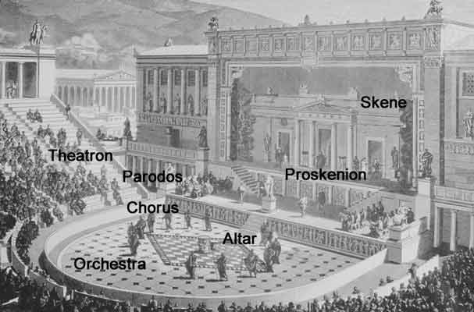
CITY DIONYSUS
THEATER:

Slide 29
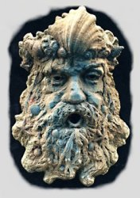
CITY DIONYSUS
ACTORS:
priests → professional actors
masks
made of cork or linen
covered full head & hair
not grotesque caricatures
but realistic, naturalistic representations
of types
bearded king, old man, young girl
masks → NO facial expressions
word + gesture = characterization
(pantomime)

Slide 30
CITY DIONYSUS
THESPIS: (6th century BC)
**1st actor:
detached himself from the Chorus
added speech of actor to the songs & dances of Chorus
engaged in dialogue with Chorus
as a god or hero
1st manager, too
*1st unsanctified person who dared to assume the character of a god
(previously, only priests & kings, partly deified)1st actor
“thespian” “thespian arts” “robes of Thespis”
leader of a dithyrambic chorus
from Icaria (eventually arrives in Athens)
*traveling stage> cart: floor & tailboard = improvised stage

Slide 31
CITY DIONYSUS
THESPIS’ changes lead to:
independent development of an “actor”
actors = choose plays, “servants of Dionysus” only by tradition
move away from temple (though always near)
*audience:
still conscious of religious significance of play
but play = work of art
play = entertainment (eventually)
spectators became “audience” not “congregation”
2nd (Aeschylus) & 3rd actors (Sophocles) → development of
dramatic narrative (between actor & Chorus)
dramatic relationship (between actors)
dramatic conflict (actor against actor)
complication of plot, characterization
→ * limits role of the Chorus (to commentator)

Slide 32
CITY DIONYSUS
CHORUS:
50, 24, 10, 12, 15 men
50 = 5 men from 10 Athenian tribes
Athenian citizens, not trained actors
citizen amateurs who represented their own tribes
civic pride to participate in the competition
represented singular identity (Theban elders, e.g.), although anonymous

Slide 33
CITY DIONYSUS
CHORUS:
surrogate for audience
expressing emotions, offering opinions, asking questions – that the average theater-goer may raise
vox humana
the mouthpiece of the people
function = emotional bridge between audience & actors

Slide 34
CITY DIONYSUS
CHORUS:
sang & danced the dithyramb
left-over from the religious ceremonies
from sole participant → to active participant → to narrator
spoke in a conventional Doric dialect
later, interacted with the actor/s
Koryphaios: Leader of the Chorus
Other functions:
exposition
thematic clarification, pronouncement

Slide 35
CITY DIONYSUS
PLAYWRIGHTS:
(1) composed all the music
(2) arranged the dances (choreographer)
(3) trained the Chorus (until specialists took over)
(4) chief actor (until actors increased in number & importance)
each submitted 3 tragedies + 1 satyr play (comedy)
tragedy = trilogy OR related on theme
satyr play = lighthearted play on the connected tragedies
3 playwrights, 3 plays, 3 days
sometimes playwrights = actors
(Aeschylus, Sophocles for a while)

Slide 36
CITY DIONYSUS
PLAYS: Tragedy
“tragedy” = “goat song”
goat sacrificed on 1st day
goat awarded on last day
more esteemed than Comedy
key aspect of theatre’s development
topics
number of plays
time of day
awards
start of day →

Slide 37
CITY DIONYSUS
PLAYS: Tragedy
start at sun rise (focus of the day)
3 plays
trilogy
OR related on theme

Slide 38
CITY DIONYSUS
PLAYS: Tragedy
Topic = related to legendary past (not contemporary issues or people)
heroes, legends, myths
from Oral Tradition
historical
myths = only type of “history” they had
poetical
characters = symbols of human existence (death, ambitions, fears, …)
religious
relationship of the gods to men
explore the mysteries of divine purpose

Slide 39
CITY DIONYSUS
PLAYS: Comedy
at the end of the day
satyr play
related to the themes of the Tragedies
Topic =
treatment of contemporary themes, issues, people
often ridiculing current person
ribald, frank “social satire”

Slide 40
CITY DIONYSUS
PLAYS: Attributes
(1) religious
to honor Dionysus
(2) civic
competition between tribes
civic duty & pride
(3) political
war orphans
democratic attributes
Theater = Democratic
inclusive
prizes awarded by 10 judges
judges = elected at start by lots
judges = sworn to impartiality
attendance = part of civic duty & pride
chorus = 50 men (5 from each of the 10 tribes of Attica)

Slide 41
END of GOLDEN AGE in GREECE
Peloponnesian Wars:
431-404 BC
Athens (& allies) vs. Sparta (& allies)
tired of Athenian dominance
Athens surrenders by starvation
“pyrrhic victory” – both = too weak to defend themselves
Macedonian Invasion shortly thereafter

