Slide 1
ANTIGONE
BACKGROUND

Slide 2
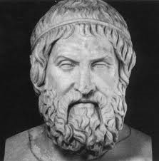
SOPHOCLES
BIOGRAPHY:
c.496 BC - c.406 BC
born in Colonus
north-west of Athens
always held in high regard
(see Oedipus Coloneus)
family = wealthy
most productive era =
under PERICLES
statesman, general (@ 495-429)
finest phase in Athenian history
period of commercial, artistic, & intellectual growth***

Slide 3
SOPHOCLES
STYLE:
unquestioning belief in the justice of the gods
humans must follow the divine order
protagonists =
strong-willed
prideful
lack of self-knowledge
→ leads to their downfall
complex plots, subtle characterization
changes:
3rd actor, complexity, reduced role of Chorus

Slide 4
SOPHOCLES
PLAYS:
wrote approximately 90 plays
from 90 to 130
110 titles
only 7 extant
produced one every other year
won 18 prizes
(at the City Dionysia)
1st or 2nd, never 3rd
(several other victories at the Lenaea)
7 extant plays:
some fragments
Electra, Ajax, Trachiniae, Philoctetes
Theban plays
Oedipus Rex, Oedipus at Colonus, Antigone

Slide 5
ANTIGONE
THEBAN PLAYS = NOT a TRILOGY
written out of order – (3, 1, 2)
Antigone (c. 442 BC)
before the outbreak of civil war (Peloponnesian Wars)
Oedipus the King (430 BC)
during early years of the wars
after the Athenian plague of 429 BC
Oedipus at Colonus (401 BC – after Sophocles’ death)
in Sophocles’ old age
in the final desperate days of the wars
independent units
not a single story arch
inconsistencies, different mythical antecedents
changing tragic vision

Slide 6
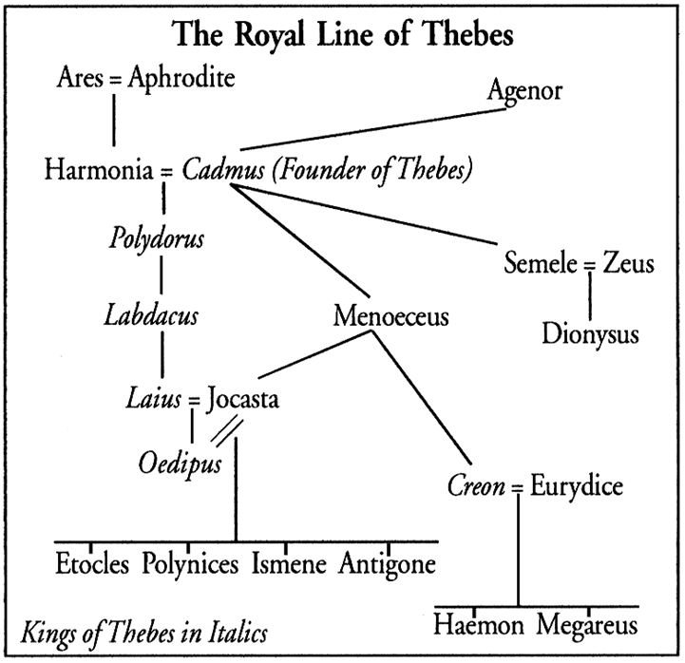
SOPHOCLES

Slide 7
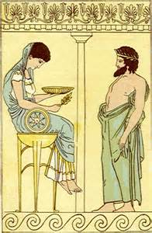
ANTIGONE
BACKGROUND:
Curse of the gods on House of Laius
Oracle of Delphi
Apollo’s oracle
prophecy warns that Laius will be killed by his son
“Oedipus”
in response, when Jocaste later bore him a son, Laius abandons the child to die in the mountains
his feet pinned & bound (“swollen foot”)
BUT
he survives - found, rescued by shepherd
taken to Corinth, adopted by King Polybus & wife

Slide 8
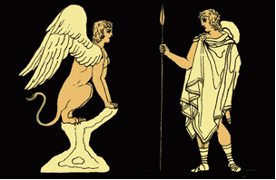
ANTIGONE
BACKGROUND:
Curse of the gods on House of Laius
Prophecy #2
as a young man, Oedipus goes to Delphi & learns
he is fated to kill his father & marry his mother
→ he vows never to return to Corinth
Prophecies fulfilled
on road to Thebes, Oedipus meets & kills his father (unbeknownst to either)
solves the Riddle of the Sphinx
& as a reward for ending the plague upon the city
becomes king of Thebes & marries Jocasta

Slide 9
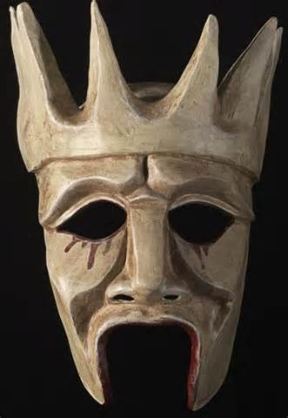
ANTIGONE
BACKGROUND:
Curse of the gods on House of Laius
Oedipus & Jocasta’s children
Polynices
Eteocles (TWINS)
Antigone
Ismene
Blinding truth
several years later, Oedipus learns the truth of his actions
blinds himself (w/Jocasta’s broaches), abdicates, exiles self
Jocasta hangs herself (w/her hair)
Creon (Jocasta’s brother) becomes regent of Thebes
until sons (in alternating years) will rule

Slide 10
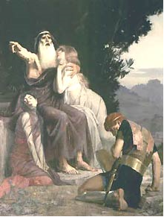
ANTIGONE
BACKGROUND:
Curse of the gods on House of Laius
Oedipus @ Colonus
rejoined w/ Ismene (w/ news of oracle)
oracle prophecy @ Oedipus’ corpse in Thebes = good
visited by Creon, Polynices – both w/ self-interest
Oedipus curses E&P as traitors (kill each in battle)
"That city you will never storm, but first will fall, you and your brother, blood-imbrued. […] This curse I leave you as my last bequest: Never to win by arms your native land, nor return to Argos, but by a kinsman's hand to die and slay."
Oedipus dies, daughters return to Thebes to try to stop bloodshed

Slide 11
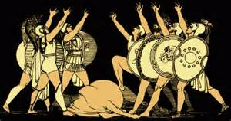
ANTIGONE
BACKGROUND:
Curse of the gods on House of Laius
Civil War
Polynices, Eteocles (older, younger) vie for throne
Eteocles exiled Polynices (to Argos)
Polynices returns w/army – 7 chieftains (“7 against Thebes”)
Polynices & Eteocles kill each other in the ensuing battle
Creon =
king of Thebes
uncle to Antigone & Ismene
soon to be father-in-law to Antigone
father of Haemon

Slide 12
ANTIGONE
OPENING:
The royal house of Thebes. It is still night, and the invading armies have just been driven from the city. Fighting on opposite sides, the sons of Oedipus - Eteocles and Polynices - have killed each other in combat. Their uncle – Creon – is now king of Thebes.
Enter Antigone, slipping through the central doors of the palace. She motions to her sister – Ismene – who follows her cautiously toward an altar at the center of the stage.

Slide 13
ANTIGONE
OPENING:
Setting –
nighttime
immediately after a civil war
brothers just fought & killed each other
no clear king – not through primogeniture
Actions –
slipping, motions, cautiously
Mood (Setting + Actions) –
fear, tension, danger, unease

