Slide 1
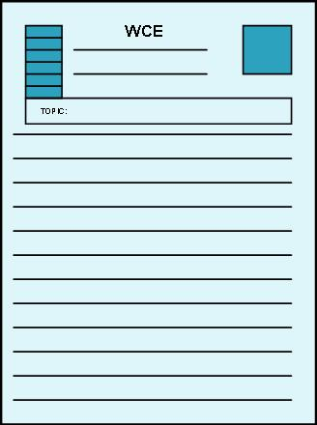
Writing Competency Exam REVIEW
Illustration
Process-Analysis
Division/Classification
Comparison/Contrast
Stephen A. Housenick, PhD
May 27, 2009

Slide 2
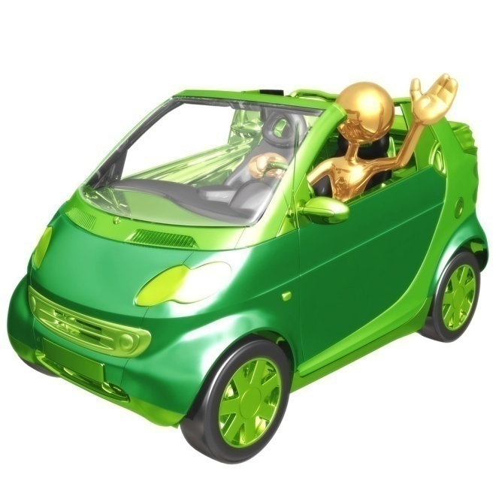
WCE PROMPT
Automobiles play a significant part in the daily lives of students at a commuter college such as Luzerne County Community College.

Slide 3
ILLUSTRATION

Slide 4
ILLUSTRATION
Writers employ various means of evidence
(especially EXAMPLES)
To support a specific claim
That is clearly stated in the Thesis Statement.
This evidence is arranged Emphatically.
And introduced with Transitions
For instance, For example.
This Rhetorical Strategy allows writers
to move from the abstract to the concrete
to write across the curriculum.

Slide 5
ILLUSTRATION + CARS
10 Reasons to Buy Hybrids
They are fuel efficient.
They are run by a gasoline engine and acceleration is run by an electric motor.
The batteries of the electric motor use the kinetic energy produced from braking to recharge. Automatically.
Hybrid cars produce fewer emissions and better mileage.
Tires of hybrid cars are made of special rubber designed to reduce friction.
Hybrid cars have high-capacity batteries and can run the car when necessary.
Hybrid cars are made of lightweight materials.
Variety: Many manufacturers produce hybrid cars (Ford, Toyota, Honda, Chevrolet, and GMC).
The US government gives tax breaks to hybrid owners.
Hybrid cars help the environment.
www.articlealley.com/article_3512_31.html

Slide 6
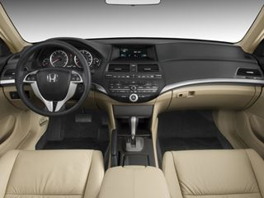
ILLUSTRATION + CARS
Reasons to Buy a Honda Accord
Interior Space:

Slide 7
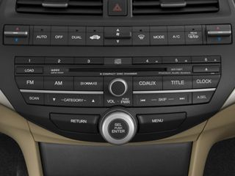
ILLUSTRATION + CARS
Reasons to Buy a Honda Accord
Sound System:

Slide 8
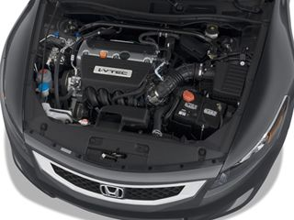
ILLUSTRATION + CARS
Reasons to Buy a Honda Accord
Engine Size:

Slide 9
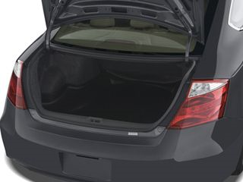
ILLUSTRATION + CARS
Reasons to Buy a Honda Accord
Trunk Space:

Slide 10
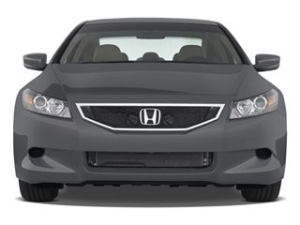
ILLUSTRATION + CARS
Reasons to Buy a Honda Accord
Brand Recognition:

Slide 11
ILLUSTRATION + CARS
Reasons to Buy a Honda Accord
Price:
$24, 505
www.edmunds.com

Slide 12
PROCESS-ANALYSIS

Slide 13
PROCESS-ANALYSIS
The careful, detailed explanation
of a particular procedure.
Writers discuss it step by step.
Writers presume the reader knows little of the process.
Writers use transitions
first, next, then
after, before
Writers arrange the steps chronologically.
By time, instead of by logic
Writers ask: Can the reader do it?

Slide 14
PROCESS-ANALYSIS + CARS
How to:
Buy a (new/used) car
Select car insurance
File an accident claim
Wash a car
Detail a car
Change a tire
Change the oil
Change the wiper blades
Change the spark plugs
Change brake pads

Slide 15
PROCESS-ANALYSIS + CARS
How to Change a Flat Tire
1
2
3

Slide 16
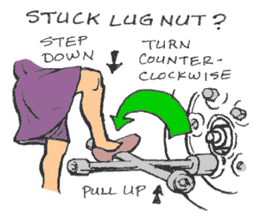
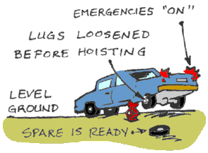
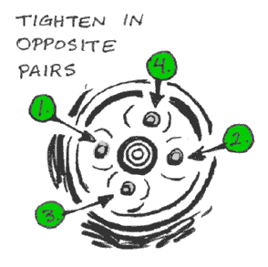
PROCESS-ANALYSIS + CARS
How to Change a Flat Tire
4
5
6
www.americredit.com/.../Learn2ChangeFlatTire.htm

Slide 17
DIVISION-CLASSIFICATION

Slide 18
DIVISION-CLASSIFICATION
Division separates a topic into
Roles
Subgroups or Subdivisions
“1 into many”
CLASSIFICATION groups into
Types or Groups
Classes or Categories
“Many into 1”
Writers use examples to support the division or classification:
specific people, instances, events, details
Writers set up each example with appropriate transitions.
Writers arrange paragraph topics emphatically.

Slide 19
DIVISION + CARS
Division
roles your car plays in your life
parts of an engine
exhaust system components
subgroups of a specific type of car
subdivisions of the SUV genre
subdivisions of the mid-size vehicle
4-Door Sedans
2-Door Coupes

Slide 20
CLASSIFICATION + CARS
Classification
types of cars in the LCCC parking lot
types of cars college students typically drive
types of cars you have owned or driven
types of drivers (witnessed while driving to school in the morning)
types of roads
types of auto-related responsibilities
types of auto-related problems

Slide 21
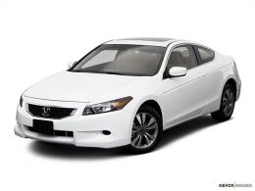
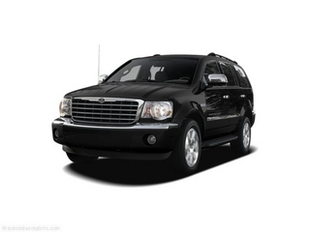
CLASSIFICATION + CARS
Mini
Sub-Compact
Compact
Mid-Size
Luxury
Sports
Convertible
Mini-Van
Van
Crossover
Sports Utility Vehicle
Pickup Truck
Hybrids

Slide 22
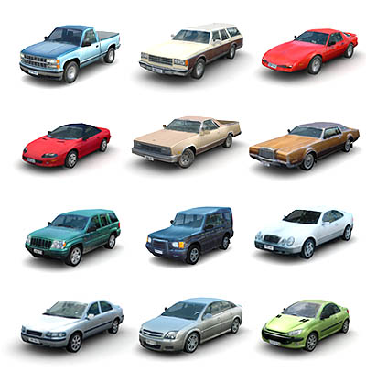
CLASSIFICATION + CARS
Tricked-Out Trucks
Junk Mobiles
Off-Road Monsters
Mom’s Taxis
Classics
Family Cars
Bondo Buggies
Vin Diesels

Slide 23
COMPARISON-CONTRAST

Slide 24
COMPARISON-CONTRAST
To compare OR contrast
Comparison (similarities)
Contrast (differences)
2 subjects
Writers employ various means of evidence.
Writers clearly state in the Thesis Statement the points of comparison or contrast.
Writers effectively and strategically employ one of two ORGANIZATIONAL METHODS:
point-by-point-by-point method
subject-by-subject method
Writers use appropriate transitions.
Writers emphatically arrange evidence.

Slide 25
COMPARISON-CONTRAST + CARS
2 dealerships
2 manufacturers
2 insurance plans or companies
2 repair shops
2 drivers
2 vehicles
from the same year
from the same class

Slide 26
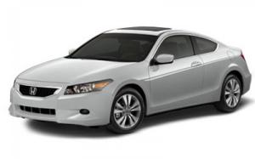
COMPARISON-CONTRAST + CARS
2009 Honda Accord EX & 2009 Pontiac G6

Slide 27
COMPARISON + CARS
2009 Honda Accord EX & 2009 Pontiac G6
Standard Features (similarities):
Power Door Locks
Front-Wheel Drive
ABS
Cruise Control/Tilt Steering
Air Conditioning
3 Air Bags
General Pricing = @ $24,500

Slide 28
CONTRAST + CARS
2009 Honda Accord EX & 2009 Pontiac G6
2009 Honda Accord EX
Gas Mileage:
21/30
Interior Room:
seating for 5
AM/FM, CD = STD
Vehicle Stability Control System = STD
Sunroof = STD
2009 Pontiac G6
Gas Mileage:
18/29
Interior Room:
seating for 5
AM/FM, CD = N/A
Vehicle Stability Control System = N/A
Sunroof = N/A
WINNER
LOSER
www.edmunds.com

Slide 29
WCE REVIEW
Prompt:
Automobiles play a significant part in the daily lives of students at a commuter college such as Luzerne County Community College.
Approach it from one of these Rhetorical Strategies:
Illustration
Process-Analysis
Division/Classification
Comparison/Contrast

Slide 30
INFORMATION LITERACY
Quality Sources:
reliable, credible
professional
NO blogs, NO Wikipedia
Quality Vehicle-Related Sources:
Library’s Databases (EBSCO)
Edmunds or NADA or Kelley Blue Book
Consumer Reports
Car & Driver
Advance Auto Parts

Slide 31
INFORMATION LITERACY
LINKS
Example & Contrast
Consumer Reports through EBSCO
data @ Kelley Blue Book
Process
Flat Tire @ You Tube
Car-Buying Advice from Edmunds.com
Classification:
Body styles @ NADA.com

Slide 32
Writing Competency Exam REVIEW
Illustration
Process-Analysis
Division/Classification
Comparison/Contrast
Stephen A. Housenick, PhD
May 27, 2009

